Slide 1

Preliminary Market Opportunities: Asterisk Vodka
***
May 2024
Notes:
https://www.pexels.com/photo/assorted-labeled-bottle-on-brown-shelf-2198400/

Slide 2
Exploratory Marketing Overview
***
Asterisk:
American food grade producer of high proof spirits, conversion from industrial to direct consumer sales
1Mgallon, 2.2ML in sales annually
Exploratory analysis: Where should global marketing start their next steps?
Where
What
Who
Price point
Is our target market
Is our consumer
Product
Demographics
Josh Still
Spend and Price
Caite Green
Nigel Brooks

Slide 3
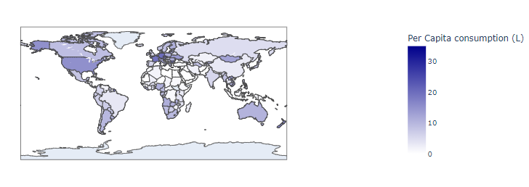
Where is Alcohol Consumption Highest?
***
Europe = highest per capita consumption
NEED: WPR/ AMR / EUR per capita and top 3 country per capita
NEED: population per country?

Slide 4
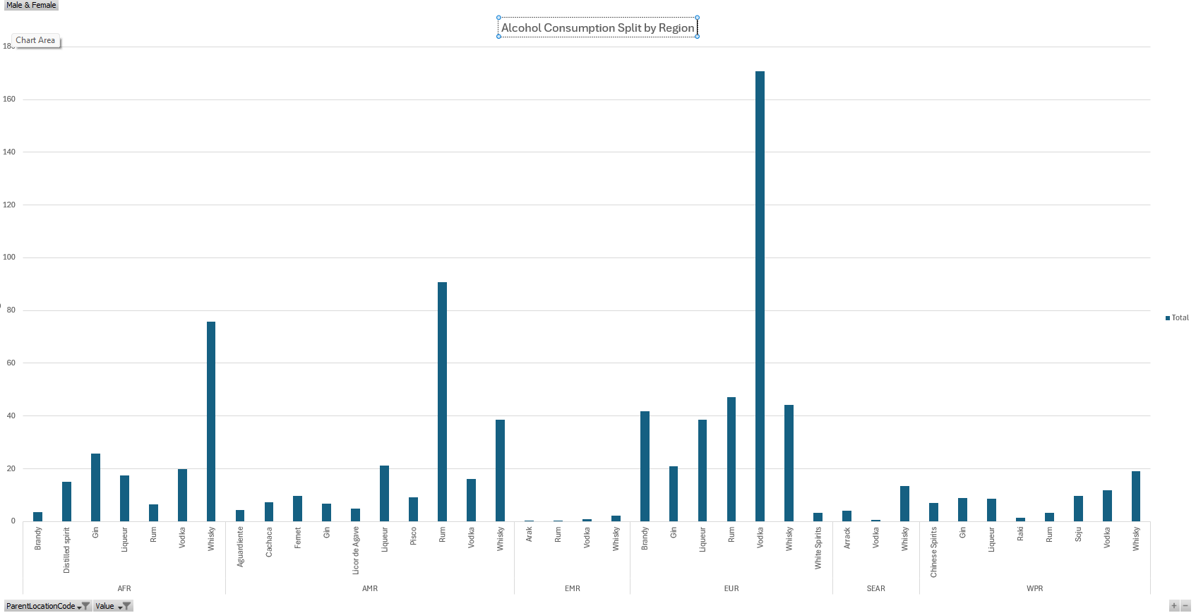
Who Drinks Vodka over other Spirits?

Slide 5
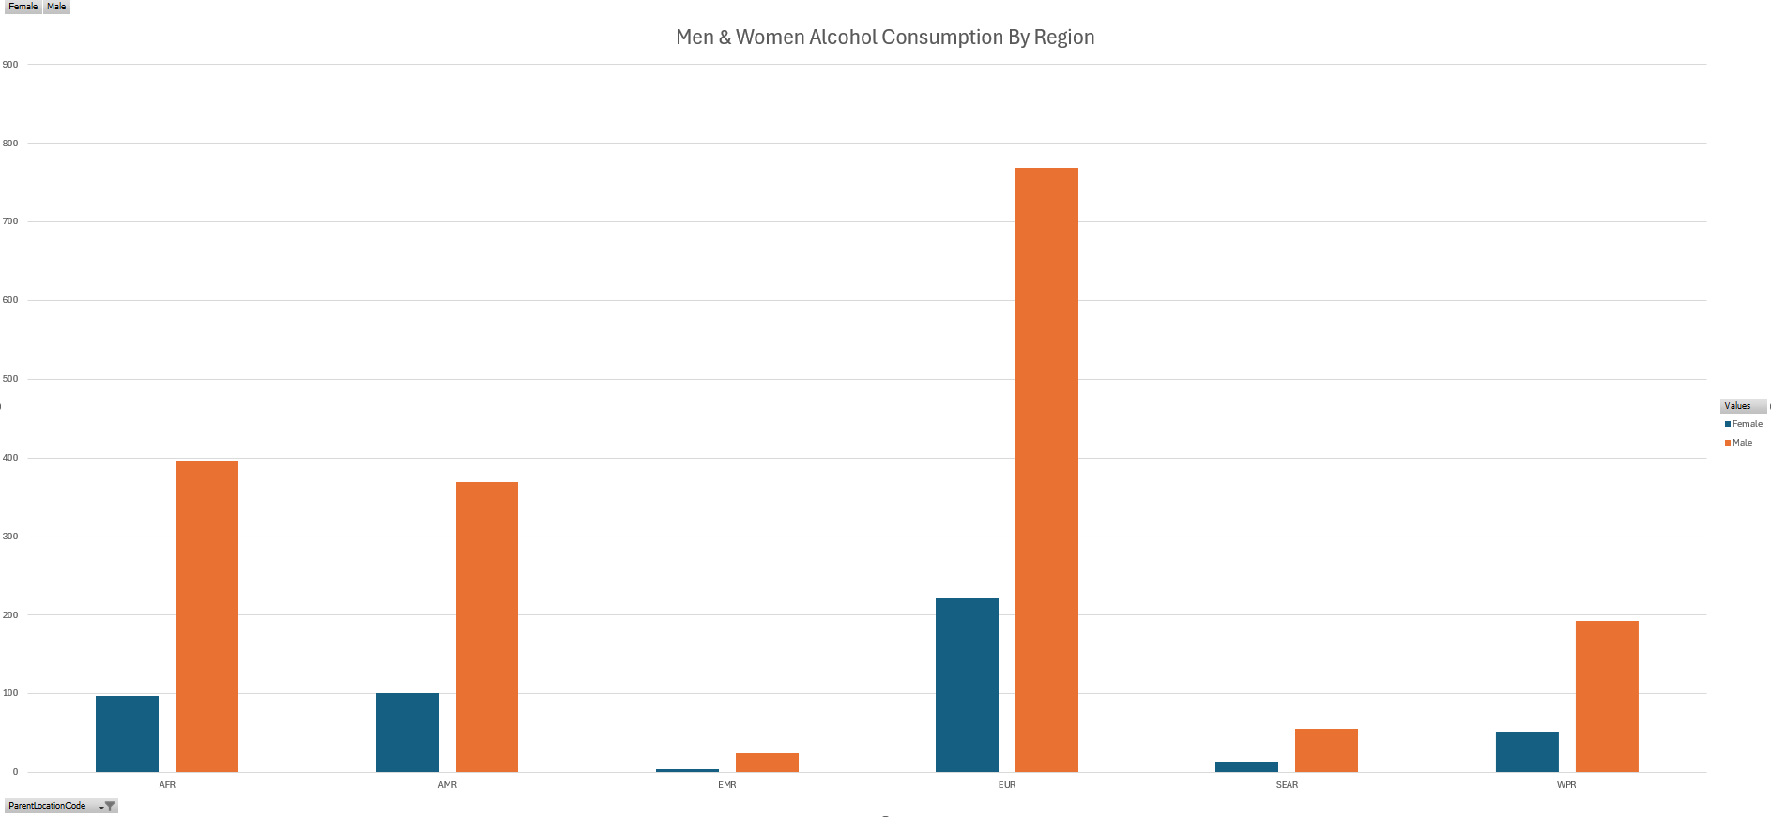
Where and Who: Regional Consumption by Gender
***

Slide 6
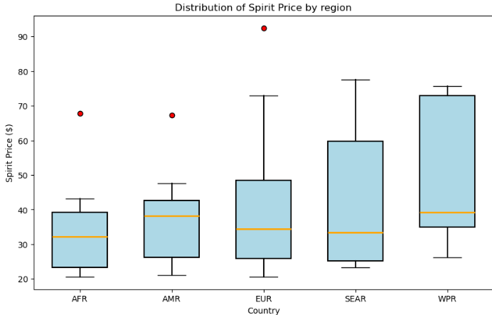
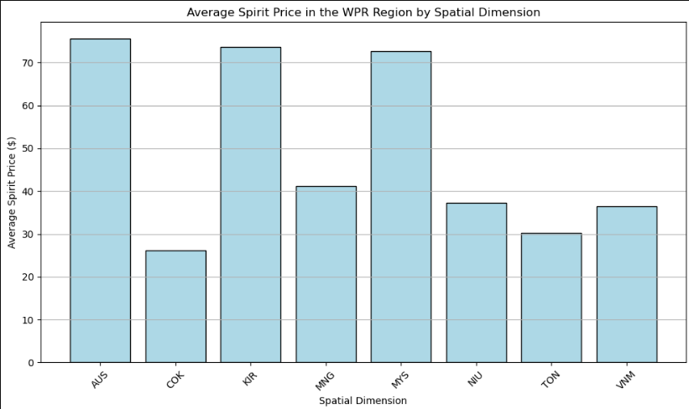
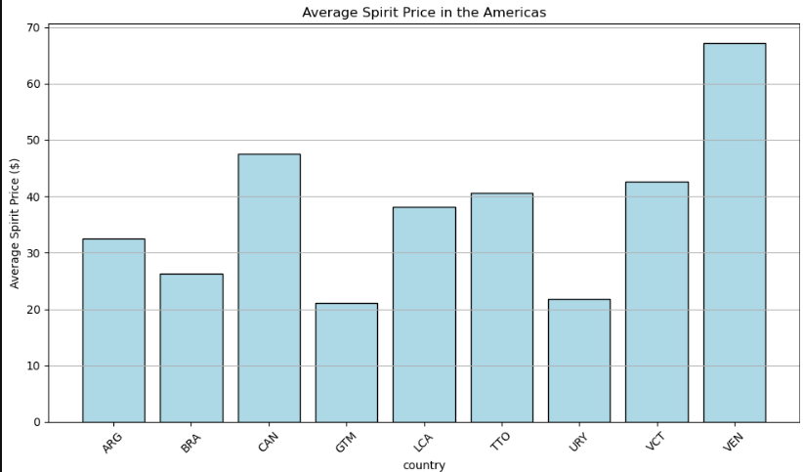
Price: Regional Prospects
***
Western Pacific and Americas : highest median pricing
Of those regions, Australia, Kiribati, Canada, Malaysia, and Argentina average over $45/L
Australia and Canada the most exciting prospects
Kiribati- small market 121k people
Malaysia- cultural taboos
Argentina- macreconomic concerns
Median price AUS
Median price CAN
Expected pricing range(+/-20% of region)
Notes:
Find median pricing in AUS and Canada

Slide 7
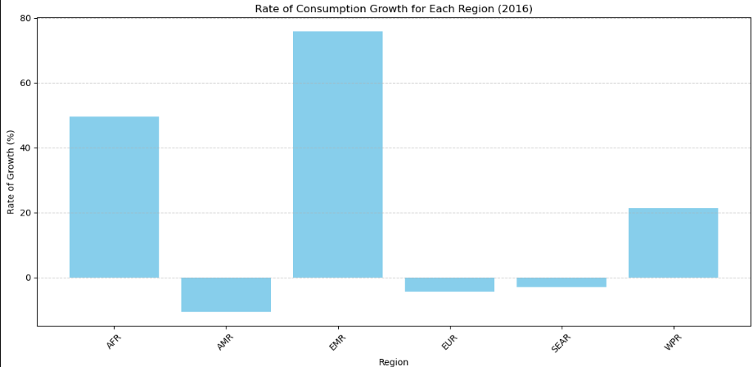
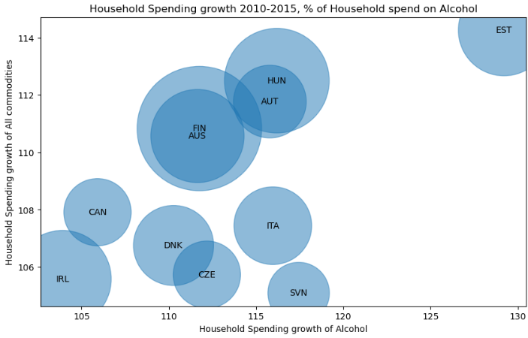
Spending : Regional Spending Growth
***
Africa and Western Pacific have highest Growth current
Middle East is a small market- noise
Estonia exciting price growth (developing)
Cultural demand (Russian influence)
Small Population
Australia and Canada highest growth in price outside of the European market
Limitations- Africa, Asia, Middle East underrepresented in OECD Data
Notes:
Fix the bubble map to show circles that have populations over 20M people as red

Slide 8



Recap
***
Canada
440 miles
35M population
% Spirit vs other Alc
Australia
10k miles
26M population
% Spirit vs other Alc
Estonia
4132 miles
1.3Mpopulation
% Spirit vs other Alc

Slide 9
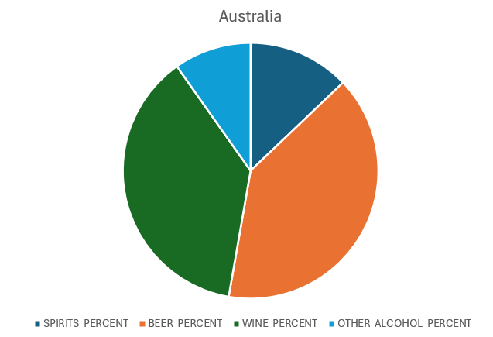
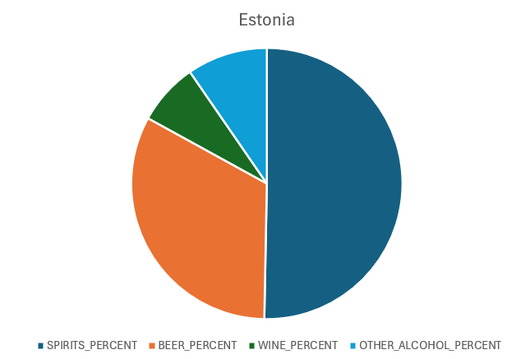
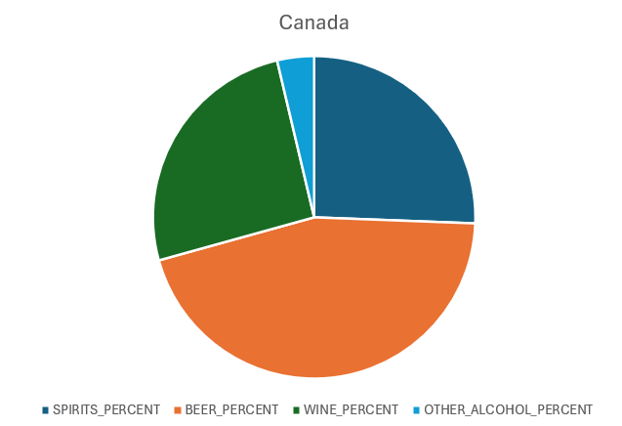
Who is buying what?

Slide 10
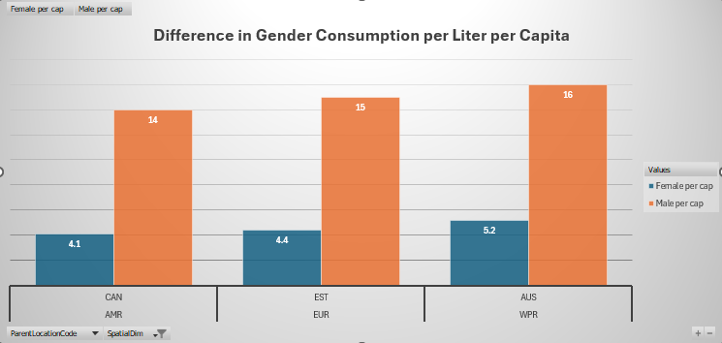
Who Drinks in the Target Country?
***
On average, every weekend, Canadian, Australian, and Estonian men drink a fifth….
Not a FACT: Average Texas Tech student drinks this before breakfast.

Slide 11
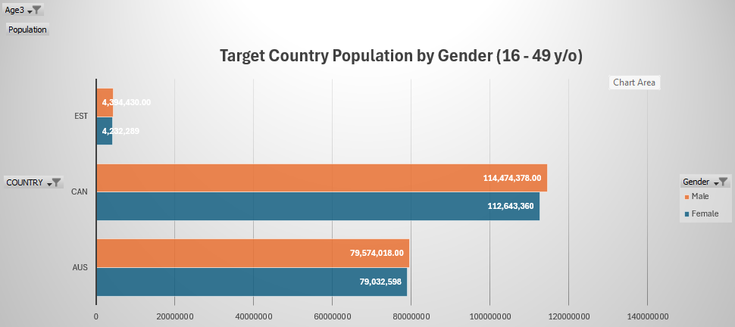
Target Countries: Drinking Age Consumers
NOTE: Women make up a higher percentage of the total population in all age ranges. Women skew older.

Slide 12
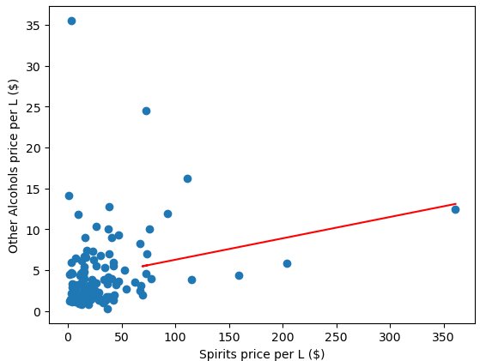
Price: Vodka vs other Alcohols
Correlation between price of spirits and other alcohols is .24
NOTES- would like to see this as a labelled bubble graph (WHO) ]
NOTES-

Slide 13
Price
***
Projected pricing of three top countries here based on Median pricing of those countries +/-20%
Linregress from 2012 to 2024

Slide 14
Limitations and Further Research
***
Tax Environment | What proportion of cost and price is tax? Is that tax producer, seller, or consumer burden?
Macroeconomic Environment | Conflict, recession, weather
Underlying Data Age | As more data becomes available for 2024, clearer pictures can be made
Distribution and Logistics | Shipping cost and time it takes to get to consumer from production facility (US) Furrher research into whether production should move might be needed
Competition | Cosmetics, industrial,and other brands
Seasonality | Drill down needed to determine the best time of year to launch based on chosen country seasonal trends
Who is buying | Women or men? Which is the BUYER vs CONSUMER
Language Barrier | Estonia vs Canada vs Australia
Brand/ National loyalty | Are there patriotic or othe reasons for spirit popularity and consumption.
Wage Growth | Where is growing markets? What is income per capita, income median, and how is that structured for our market audience in each country
Accessibility | Distance to point of sale, ecommerce, express couriers
Age Range | What is the legal drinking age and how does that affect consumption patterns

Slide 15
Resources
https://www.statista.com/statistics/256598/global-inflation-rate-compared-to-previous-year/
https://genderdata.worldbank.org/en/indicator/sh-alc-pcap-li
https://www.who.int/data/gho/info/gho-odata-api- "drinks.csv“
https://gist.github.com/aegorenkov/f7f0f8d6e9cc17ca9774572e224e2ad14- PLotly map-making help
https://www.datacamp.com/tutorial/making-map-in-python-using-plotly-library-guide
https://stats.oecd.org/Index.aspx?DataSetCode=SNA_TABLE5_ARCHIVE
https://data.oecd.org/pop/population.htm

Slide 16
PLEASE DRINK RESPONSIBLY

